Slide 1
Creole & Creolisation
Origin of Creolization theory
Lies within the processes of colonization, slavery, and migration which created the foundation of the New World
As a result of the Slave Trade, Africans of diverse cultural backgrounds came into contact with people from Europe, China, South Asia and Middle East.
Caribbean became a melting pot of cultures and hence creolization came into effect.
People:
Language:
Europeans born in the Caribbean
People of mixed race – Mulatto
Mixture of English & African tribal languages into a special kind of native languages (Patois, French Patio, Jamaican Patois)

Slide 2
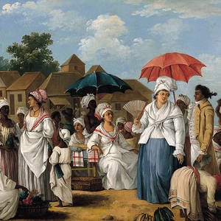
Creole
Creolization:
Cultural process that took place within a creole society
Creole society – tropical colonial plantation based on slavery
Therefore, Caribbean islands were attached to & dependent on Britian for it’s ecojomic well-being, protection, and cultural models

Slide 3
Creole & Creolisation Several meanings in the Caribbean
Lowenthal - Creole was originally used to define African slaves born in the new world. Later extended to “…anyone, black or white, born in the West Indies…then extended to things, habits and ideas…opinions expressed”
Nettleford, - “Whites born in the American colonies were regarded as Creole by their metropolitan cousins. Jamaican born slaves were similarly differentiated from their “Salt Water Negros” colleagues freshly brought in from West Africa. Genuine Caribbean expressions - regarded as those “creolized” into indigenous form
Creolization
Braithwaite - Creolization - process through which various groups in the Caribbean society absorb each other’s cultural products.
The Africans and Indians imitated or forced to imitate the Europeans.
Europeans inadvertently /consciously absorbed some of the cultural styles, languages and mores of the subordinate groups.

Slide 4
Creolization of Indian Women in Trinidad & Tobago
Creole
an offensive term used to refer to Indian women in Trinidad and Tobago.
Mainly used in relation to people of colour or people of African descent, especially men, and also Indian women who changed both their eating and dress habits and adapted non-Indian social customs.
In Trinidad and Tobago
Creole was used to refer to the African slaves, primarily to distinguish them from the indentured Indian immigrants.

Slide 5
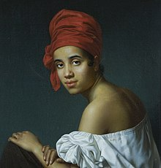
Creole Society Model
Three levels:
Upper class
whites who were Creoles, Americans, and inhabitants of European origin (the Creoles were the majority of the white population).
Middle class
free Blacks, emancipated slaves and their descendants
Lower class
slaves who were household property

Slide 6
Creolization & its Origins
Origins of Creolization
NB: Research the following: Creole cultural practices (e.g. religion, dances, foods, family life, politics, etc.).
Migration
Slavery
Colonization
Africans and Indians acculturated while the European’s process was defined as inter-acculturation.
Acculturated – imposition of a dominant group’s way of life on another group so that the former becomes assimilated into the life of the dominant group
Inter-acculturation – cultural mixing that occurs in a plural society where ethnic groups may live with limited mixing, yet elements of their cultures become incorporated into each other’s way of life

Slide 7
